Slide 1
Unitil Smart Grid Pilot Pilot Design and Results
Electric Grid Modernization Working Group Customer Facing Subcommittee
January 9, 2013

Slide 2
Unitil Smart Grid Pilot
Utility Goals and Objectives
Pilot Overview
Results & Observations
1

Slide 3
Goals and Objectives
Meet Regulatory Requirements:
MA Green Communities Act, signed July 2008
NH’s instigation of Energy Policy Act of 2005, concluded in 2008, encouraged Unitil to initiate a TOU Pilot Program.
Future DR program decisions: Obtain results on impacts, costs, and customer satisfaction
Test capabilities of current AMI metering environment
Investigate IT projects: Test and gain experience with MDM system, billing integration, and online web portal
Maintain high customer satisfaction!
2

Slide 4
Residential Pilot Structure
“Energy Savings Management”
Simple TOU
76 Customers
Time of Use pricing
No technology
Control Group
76 Customers
Flat rate pricing
No technology
Enhanced TOU
76 Customers
Time of Use pricing
In-home Energy Management System
Smart Thermostat
76 Customers
NO Time of Use pricing
Direct A/C Load Control
3

Slide 5
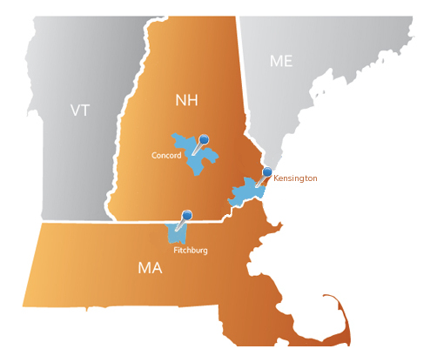
Distribution of Customers by State
Sample Group | Mass | NH
Time of Use | 24 | 52
Enhanced Technology | 24 | 52
Smart Thermostat | 24 | 52
Control Group | 24 | 52
Commercial TOU |  | 30
Totals: | 96 | 238
4

Slide 6
Project Schedule
April 6th, 2011 Initiate in-home installations
April 20th, 2011 Enrolled 2nd batch of customers
May 6th, 2011 Customer web portal active
May 13, 2011 Billing System Tested
May 18, 2011 In-home installations complete
June 1, 2011 Pilot Begins
August 31, 2011 Pilot Ends
October 2011 Evaluation and Reporting
Dec. ‘11 - Jan ‘12 Filed Report with DPU & NHPUC
5

Slide 7
Weekday Time of Use Rate (Non-CPP)
Weekday TOU Rate (Non
- CPP)
“On-Peak”
12pm-6pm Weekdays.
“Off-Peak”
Mornings, Nights, Weekends & Holidays.
$0.14
$0.12
$0.10
on
-
peak period
$0.08
10.846¢ / kWh
$0.06
$0.04
off
-
peak period
off
-
peak period
4.748¢ / kWh
4.748¢ / kWh
$0.02
$0.00
12:00 AM
6:00 AM
12:00 PM
6:00 PM
11:00 PM
6
6
Notes:
6

Slide 8
Critical Peak Weekday TOU Rate
5 Critical Peak Periods declared during the 3 month pilot period
Customers notified by 5pm day prior by phone & email
Critical Peak Weekday TOU Rate
$0.70
Critical
-
$0.60
peak period
64.642¢/ kWh
$0.50
$0.40
$0.30
$0.20
off
-
peak period
off
-
peak period
$0.10
4.748¢/ kWh
4.748¢/ kWh
$0.00
12:00 AM
6:00 AM
12:00 PM
6:00 PM
11:00 PM
7
Notes:
7

Slide 9
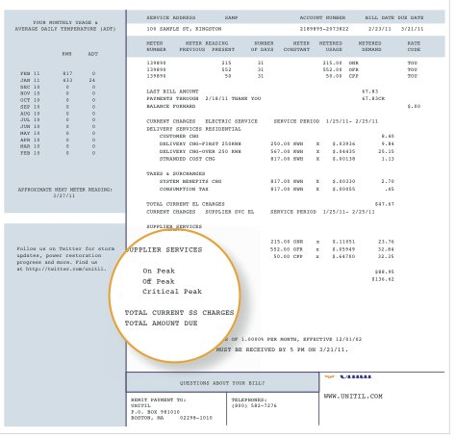
Simple TOU Group
Low cost DR option using existing metering technology
Customers placed on time of use rate plan (On-Peak, Off-Peak, Critical Peak)
No In-Home Technology
Customers receive access to web portal showing prior day usage & cost
8
8
Notes:
8

Slide 10
9

Slide 11
Unitil Web Portal – Usage Presentation
10
Notes:
JCE – 3 or 4 minutes
History discussion
Existing AMI with TOU capability
Previously completed review of DR opportunities; targeted TOU as most cost effective approach
Regulatory requirements to conduct smart grid pilots; MA GCA (5% reduction target in demand and energy, TOU or hourly pricing);
Utility Goals
-Test capabilities of AMI system
-Evaluate cost effectiveness of different DR approaches
-New projects (MDM-p, web portal)
-Evaluate price elasticity – customer response to different price points (why we wanted multiple price points)
Pilot Design MJS add rates to notes
Residential customers with central AC
Pricing was determined based on actual LMP pricing from prior year for on and CPP periods; TOU rates were designed to be revenue neutral for an average residential customer
First group is low-cost / no-cost approach. Information only. Easily rolled out to customers
Enhanced technology group that tested incremental impact of adding home area network to TOU/CPP pricing
Third group is utility controlled, flat rate

Slide 12
Unitil Web Portal – Cost Presentation
11
Notes:
JCE – 3 or 4 minutes
History discussion
Existing AMI with TOU capability
Previously completed review of DR opportunities; targeted TOU as most cost effective approach
Regulatory requirements to conduct smart grid pilots; MA GCA (5% reduction target in demand and energy, TOU or hourly pricing);
Utility Goals
-Test capabilities of AMI system
-Evaluate cost effectiveness of different DR approaches
-New projects (MDM-p, web portal)
-Evaluate price elasticity – customer response to different price points (why we wanted multiple price points)
Pilot Design MJS add rates to notes
Residential customers with central AC
Pricing was determined based on actual LMP pricing from prior year for on and CPP periods; TOU rates were designed to be revenue neutral for an average residential customer
First group is low-cost / no-cost approach. Information only. Easily rolled out to customers
Enhanced technology group that tested incremental impact of adding home area network to TOU/CPP pricing
Third group is utility controlled, flat rate

Slide 13
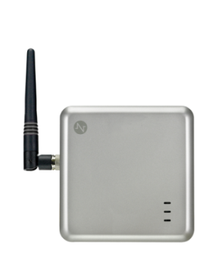
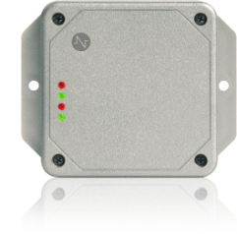
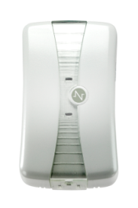
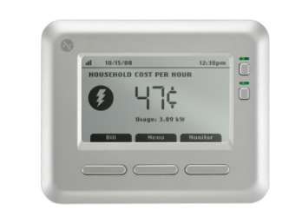
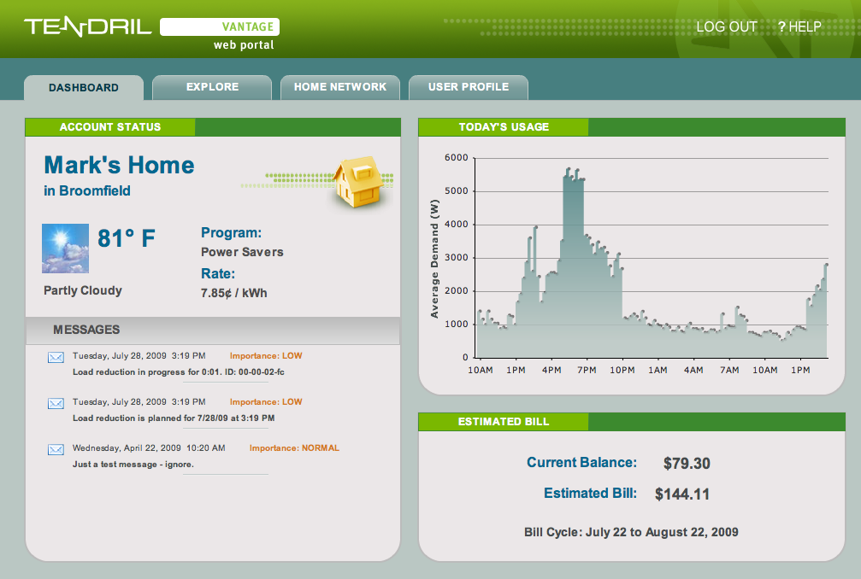
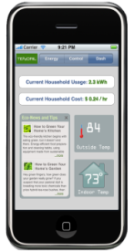
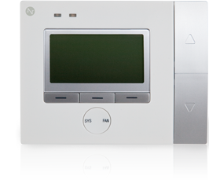
Enhanced Technology Group
Tested the incremental impacts of the Home Area Network (HAN)
More granular feedback on energy consumption including some appliances
The HAN can be configured to automatically control A/C and other appliances in response to price signals
Tendril Translate (ERT Bridge)
Tendril Transport (gateway)
Tendril Volt (outlet)
Tendril Insight
(in-home display)
12
Tendril Mobile
Tendril Set Point
Vantage Online Web Portal
12
Notes:
12

Slide 14
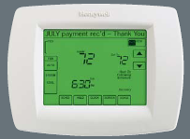
Smart Thermostat Group
NO TOU Rate – Customers remain on current fixed rate
Customers provided with a “smart” thermostat that Unitil has the ability to control during peak events
On Critical Peak Events, Unitil cycled A/C systems 30 min on/off
Customers have the ability to “opt-out” of control events using the Yukon web portal
Customers who do not opt out of events are eligible to receive a $35 incentive at the end of the pilot
13
13
Notes:
13

Slide 15
Pilot Program Results
14

Slide 16
Additional Findings
Process Findings:
Customer Recruitment –
Only 30% eligible due to central air
75% turn down due to system incompatibilities
Billing – automation and integration is a requirement
Data Management – MDM needed for Web Portal
CPP Notifications – Customer information tracking
Customer Service Training
Technology Findings:
AMI:
TOU Capabilities Confirmed
Reliable
Back-to-back CPP issues
HAN challenges:
Increased turndown
Increased failure rate
Installation logistics
Over the air updates
Interval data losses
PCT paging coverage
Unitil Portal Successful but difficult to maintain
15

Slide 17
Customer Observations
More than 4 in 5 had a positive experience
However, 85% of Commercial customers would not have participated without Bill Protection
Satisfaction decreased slightly as the level of technology increased
42% of participants with HANs experienced equipment issues
13% of participants with PCTs only experienced equipment issues
Many experienced problems with usability of thermostats
Corporate structure inhibited communication for about 20% of Commercial customers
Actions undertaken during CPP events
Avoided use of appliances (78%)
Pre-cooled home (56%)
Sought activities outside the home (44%)
Some reported aggressive actions such as shutting off main circuit breaker (impact to HANs), AC, or WH
16
Notes:
JCE 1 to 2 min
Surveys were completed by roughly 40% of Unitil Pilot participants, are following up with non respondents
Smart thermostats are not always that intuitive (newer products worse than tried and true)

